Slide 1
‘An Introduction to the ‘Sedgefield Learning Box’

Slide 2
‘An Introduction to the ‘Sedgefield Learning Box’

Slide 3
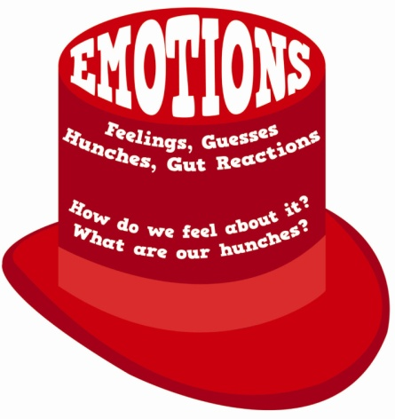
‘An Introduction to the ‘Sedgefield Learning Box’
Learning to Think
Write a letter to your head teacher in which you explain your feelings about the new school rule about…
Dear Sir,
Your new school rule has left me feeling extremely angry.
Your faithfully,
____________________________

Slide 4
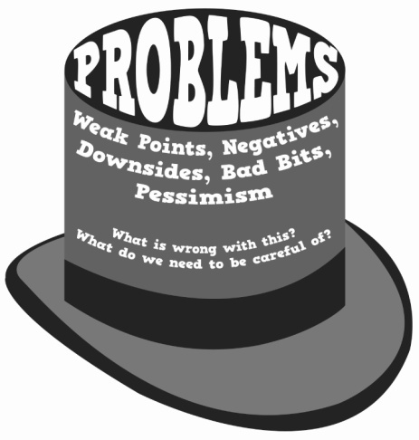
‘An Introduction to the ‘Sedgefield Learning Box’
Learning to Think
Write a letter to your head teacher in which you explain your feelings about the new school rule about…
Dear Sir,
Your new school rule has left me feeling extremely angry. I feel that it is a terrible idea because _______________________. As well as this, I also feel that it is going to be ineffective as…

Slide 5
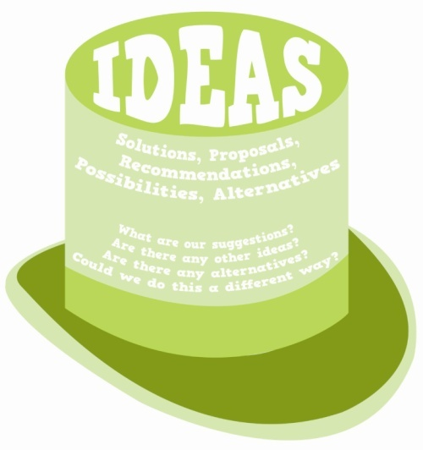
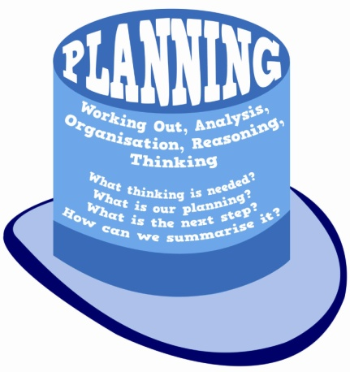
‘An Introduction to the ‘Sedgefield Learning Box’
Learning to Think
Write a letter to your head teacher in which you explain your feelings about the new school rule about…

Slide 6
‘An Introduction to the ‘Sedgefield Learning Box’
De Bono’s Thinking Hats
When using the Red Thinking Hat, we need to focus on our emotional response to the issue being discussed. Don’t spend long with the Red Thinking Hat or you will start to justify your feelings and this isn’t something that you need to do.
The White Thinking Hat is associated with facts and information. It is used to gather together the information that is known about the topic being discussed without making any kind of judgement about the facts and information that are identified.

Slide 7
‘An Introduction to the ‘Sedgefield Learning Box’
De Bono’s Thinking Hats
The Yellow Thinking Hat is associated with positive thinking and identifying the benefits / strengths / positives relating to the issue that is being discussed. Even if you aren’t inclined to see the benefits, the Yellow Thinking Hat encourages us to consider them.
The Black Thinking Hat is associated with negative thinking and identifying the problems / weaknesses / negatives relating to the issue that is being discussed. Even if you aren’t inclined to see the problems , the Yellow Thinking Hat encourages us to consider them.

Slide 8
‘An Introduction to the ‘Sedgefield Learning Box’
De Bono’s Thinking Hats
The Green Thinking Hat is associated with creative thinking and the generation of new ideas. It often makes sense to use it after the Black Hat to find solutions to problems. When wearing the Green Thinking Hat any idea should be suggested.
The Blue Thinking Hat is associated with planning and organising your thinking. Looking back at the ideas that have been generated with the other thinking hats, you can use it in order to summarise the key information and also to identify what should be done next.

Slide 9
‘An Introduction to the ‘Sedgefield Learning Box’
De Bono’s Thinking Hats
Really simple and straightforward and something students will quickly understand and internalise.
Provides a consistent structure for thinking and one that can be used across all of the different subjects.
Very flexible – you can use all of the hats, some of the hats or only one of the hats as might be necessary.
Using the Thinking Hats will lead to deeper thinking and students developing their ideas in more detail and more independently.

Slide 10
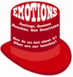
‘An Introduction to the ‘Sedgefield Learning Box’
De Bono’s Thinking Hats
Introduction
Rhetorical question (?)
Personal pronouns (you)
Exclamation (!)
Paragraph Two
A benefit of doing more sport.
Firstly / First of all...
Paragraph Three
A second benefit of doing more sport.
Secondly / In addition to this / Furthermore...
Conclusion
Finish off and draw attention to key ideas
In conclusion / Ultimately
Paragraph Five
Two ideas about how these problems might be solved.
However / Although...
Paragraph Four
A problem(s) doing more sport.
On the other hand / Alternatively...

Slide 11
Using The Learning Box @ Home
Three Great Ways of Using Thinking Hats
1) What do I know and what do I need to know?
Use the White Thinking Hat to identify what you already know about the subject that you are working on and then to work out what you now need to know. Next, use the Blue Thinking Hat to identify how you will go about finding out the information that is required.
2) Generating and then testing an idea
Use the Green Thinking Hat to come up with lots of different ideas for the task that you have been set. Then use the Yellow and Black Thinking Hats to consider each of these ideas and ‘test them’ to find out which is the right one to pursue.
3) Thinking about all aspects of an issue
To help you to develop your ideas for a task in detail, you might like to use each of the six Thinking Hats to help you to consider different elements of the topic.

Slide 12
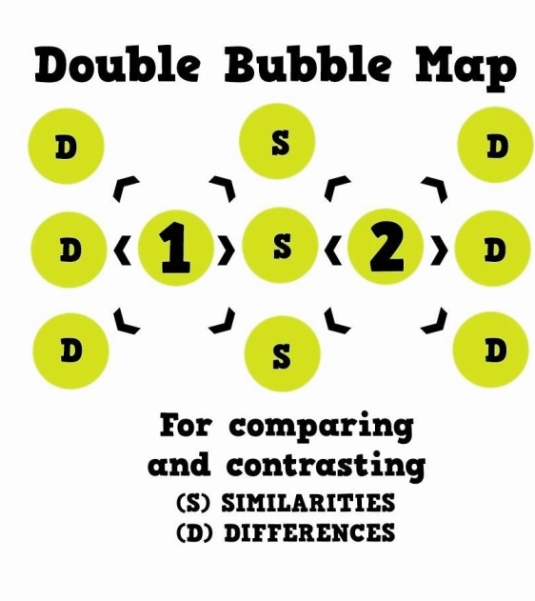
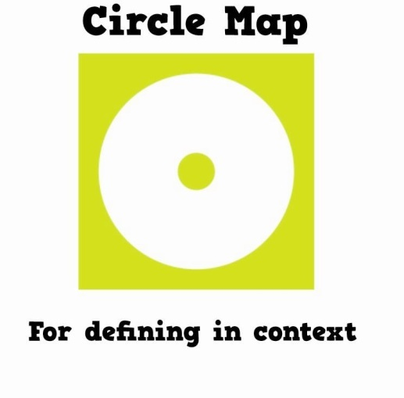
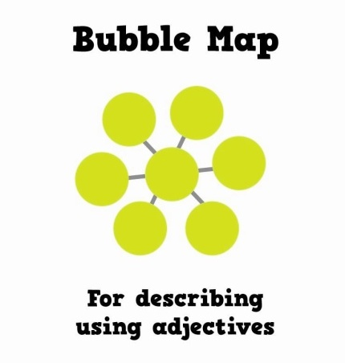
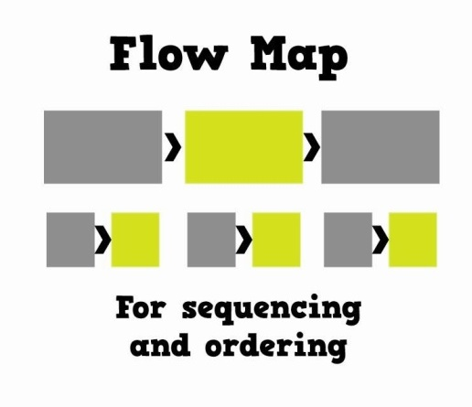
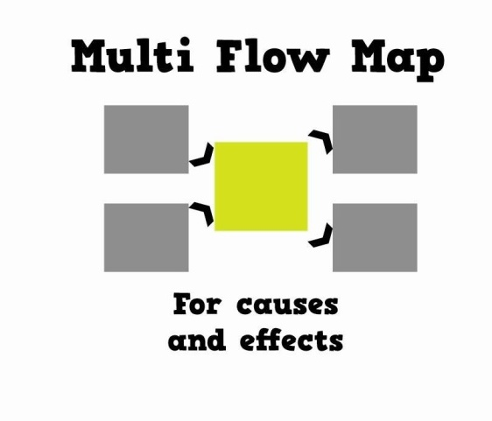
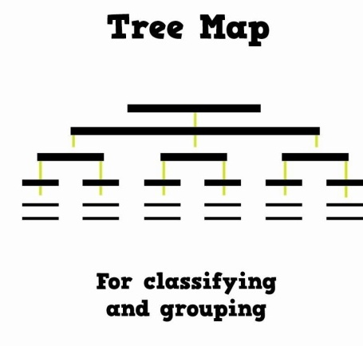
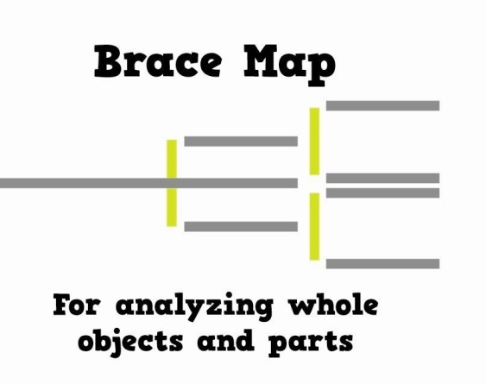
‘An Introduction to the ‘Sedgefield Learning Box’
David Hyerle’s Thinking Maps

Slide 13
‘An Introduction to the ‘Sedgefield Learning Box’
David Hyerle’s Thinking Maps
I already do something a bit like that!
Well why not do something just like that so the students become familiar with it and can start to use it for themselves!

Slide 14
‘An Introduction to the ‘Sedgefield Learning Box’
The Circle Map is used for generating ideas about a topic without forming any connections or looking to organise them. After putting ideas in a Circle Map, we can then begin to think about how we might organise them and this could lead to a second Thinking Map being used.
In the small circle write or draw what it is that you will be thinking about.
Write or draw the information that you have about this anywhere within the larger circle.
Defining in Context

Slide 15
‘An Introduction to the ‘Sedgefield Learning Box’
The Bubble Map is used for describing a person, place, object, etc using adjectives. One way of extending the Bubble Map further is to draw a frame of reference (square) around it and record your evidence for each adjective inside this.
In the inside circle, write or draw whatever it is that is being described.
In the outer circles write adjectives that describe this. Remember to draw as many bubbles as you need.
Describing with Adjectives

Slide 16
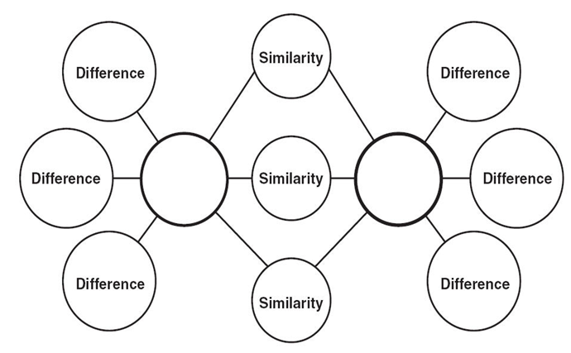
‘An Introduction to the ‘Sedgefield Learning Box’
The Double Bubble Map is used for comparing and contrasting any two things or ideas. Obviously, to compare two things we already need to know about them and it can work well to complete two separate Circle Maps, Bubble Maps, Flow Maps etc first before using the Double Bubble.
The two things being compared and contrasted.
Draw as many bubbles as you need for the similarities and differences.
Comparing and Contrasting

Slide 17
‘An Introduction to the ‘Sedgefield Learning Box’
The Flow Map is used for organising information into a clear sequence. You need to identify how many stages that you need and if it is helpful to do so, you can break these stages down into sub-stages. As a general rule, the information always flows from left to right.
Stage
Stage
Stage
substage
substage
Stage
Stage
A correctly drawn Flow Map should always have its own title so people reading the map are instantly aware of the process that it represents.
Sequencing and Ordering

Slide 18
‘An Introduction to the ‘Sedgefield Learning Box’
The Tree Map is a tool that helps us to classify things and ideas. On the top line of the Tree Map, the category name or main idea being considered should be written. A connecting line then comes down and connects together the various sub-categories or supporting ideas.
A Tree Map can be organised into however many sub-categories are needed to effectively categorise whatever is being considered.
Classifying and Grouping

Slide 19
‘An Introduction to the ‘Sedgefield Learning Box’
The Brace Map is used to take one physical object and then to break it down into the parts that go together in order to make it. On the line to the left of the Map, write the name of whatever is being broken down. On the lines within the first brace to the right, write the major parts of the object. As the braces move further to the right, the parts will become smaller and smaller.
Part
Part
Part
Whole object
Part
braces
Part
If a Brace Map has been constructed correctly, whatever is in the right of any one brace should combine together to make whatever is to the left of that same brace.
Analysing Whole Objects and Parts

Slide 20
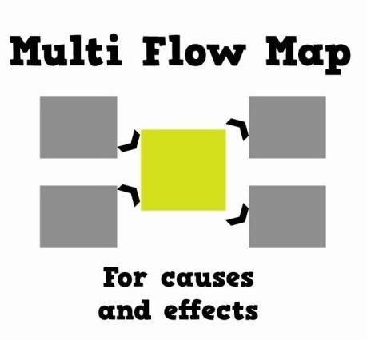
‘An Introduction to the ‘Sedgefield Learning Box’
The Multi-Flow Map is used to consider the causes of something taking place and then to think about the effects that this would have. It should be stressed that it can be both ‘definite’ and ‘possible’ causes and effects that are considered.
The ‘happening’ should go into the central box of the Map.
On the left and right draw as many boxes as are needed for the causes and effects and make sure the arrows are pointing in the right direction.
The ‘Happening’
Causes and Effects

Slide 21
Using The Learning Box @ Home
Three Great Ways of Using Thinking Maps
1) Planning an extended piece of writing
Begin by using a Circle Map to identify lots of different thoughts about what you might choose to include in your writing. Having generated lots of possible thoughts, then use a Flow Map to organise these into a clear sequence.
2) Exploring causes and effects
The Multi-Flow Map is one of the most adaptable Thinking Maps and might have more uses that you initially think. Use it to consider historical events, geographical events, scientific processes, etc. Another really good use of this Map is to help you to analyse a character’s behaviour in a story.
3) Developing Your Vocabulary
Using the Thinking Maps can help you to improve the quality of your writing. Before beginning a writing task, you might use a Bubble Map to identify lots of appropriate adjectives that you might use and to help you to increase the range of these.

Slide 22
‘An Introduction to the ‘Sedgefield Learning Box’
The ‘Big Question’
What qualities do we want our students to develop during their time at SCC?
To be able to persist when the work is challenging.
To be able to communicate effectively with others.
To be able to think creatively.
To be polite and courteous with an excellent sense of humour.

Slide 23
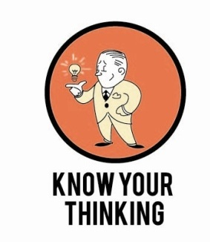
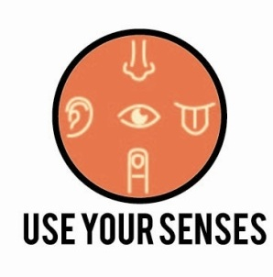
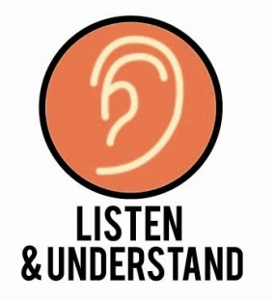
‘An Introduction to the ‘Sedgefield Learning Box’
The ‘Difficult Question’
How do we actually support our students to develop these qualities?

Slide 24
‘An Introduction to the ‘Sedgefield Learning Box’
The Habits of Mind are 16 ‘habits’ identified by the American professor Art Costa that the most ‘successful’ people are able to demonstrate when it would be helpful to do so.
Costa suggests in his research that it is possible for people to ‘grow’ their ability in being able to demonstrate each of these ‘habits’.
At SCC we look to support our students to develop these ‘habits’ by gradually raising their awareness of these habits during their time at the school.

Slide 25
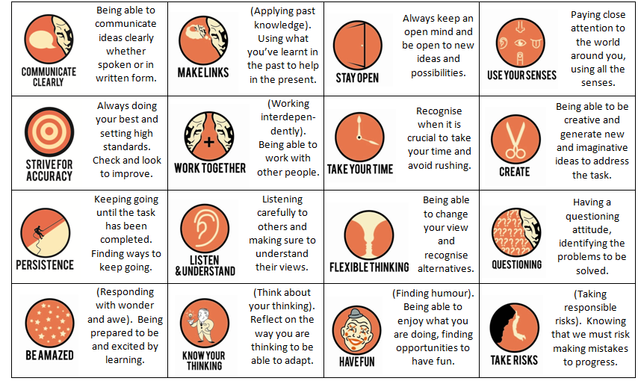
‘An Introduction to the ‘Sedgefield Learning Box’

Slide 26
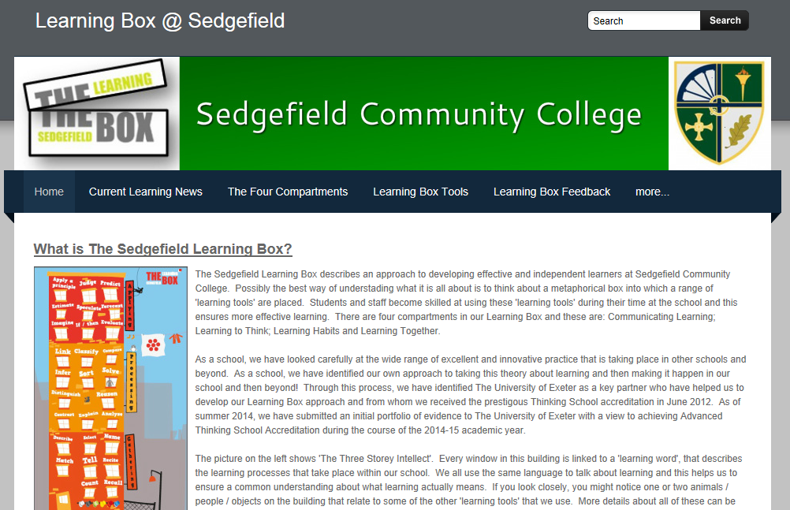
‘An Introduction to the ‘Sedgefield Learning Box’
Further details about the Sedgefield Learning Box are available via the school website. Students have key information about our Learning Box in their planners.

